Slide 1


Web Programming 2x1
Running JavaScript

Slide 2
Outcomes
Students should understand the following outcomes, upon successful completion of this module:
Setting up the IDE
Tour of language features
Basic input and output

Slide 3

Making Stuff Happen!!!
DEMO
Notes:
All students should now have VS Code installed

Slide 4
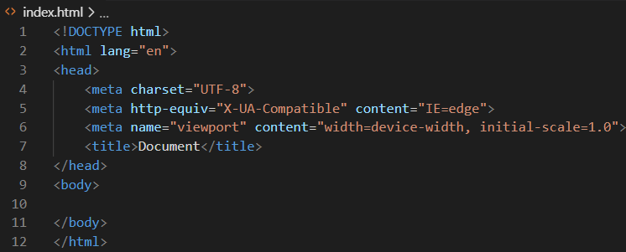
Loading Basic HTML
Create a folder on desktop: firstprogram
Open VS Code; Navigate to folder, and open in VS Code
Create index.html file.
On index.html, generate HTML code by typing: !+Tab key (known as Emmet)
Notes:
There’s a few ways to try out JavaScript, and when learning it’s best to try them out to see what works for you.
! + Tab key generates basic HTML code in VS Code (known as Emmet)

Slide 5

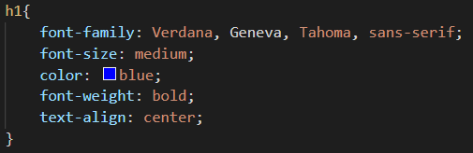
Loading Basic HTML and CSS
Lets add an <h1> tag in the HTML:
Lets create an CSS file, to bring some styling to the HTML page
In VS Code; Create styles.css file.
Add the following style to the <h1> tag:
Run your HTML file using Live Server to view on browser
Notes:
These are the basics of HTML and CSS from 1st year. Now we learn JavaScript

Slide 6

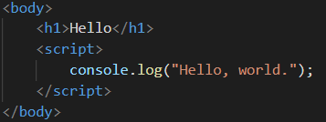
Enter JavaScript
JavaScript runs in your web browser alongside HTML and CSS, and can be added to any web page using a script tag.
The script element can either contain JavaScript directly (internal) or link to an external resource via a src attribute (external).
Internal
A browser then runs JavaScript line-by-line, starting at the top of the file or script element and finishing at the bottom (unless you tell it to go elsewhere).
Notes:
There’s a few ways to try out JavaScript, and when learning it’s best to try them out to see what works for you.
The browser will first print Hello in browser, then run internal JavaScript in the <script> tag

Slide 7
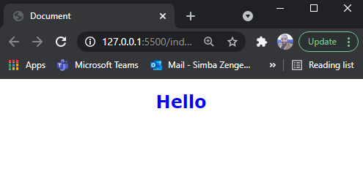
How JavaScript Gets Loaded on Browser
Load your HTML file with Live Server:
Only HTML and CSS loads - on the browser.
To see how JavaScript code was run or not, we need to open the browser and check in the browser console, under Inspect
Notes:
There’s a few ways to try out JavaScript, and when learning it’s best to try them out to see what works for you.

Slide 8
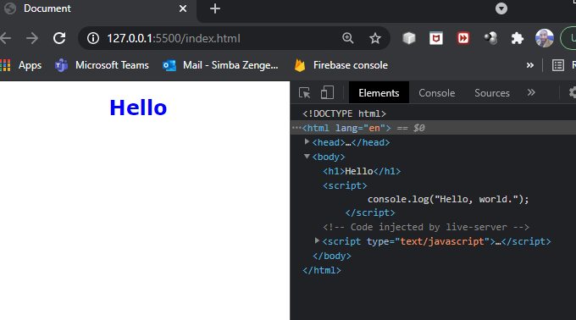
How JavaScript Gets Loaded on Browser
Right click on the browser, click Inspect:
Shows all the Elements on your HTML file
Notes:
It first shows all the Elements on your HTML file, in this case: html, head, body and h1, script elements as well

Slide 9
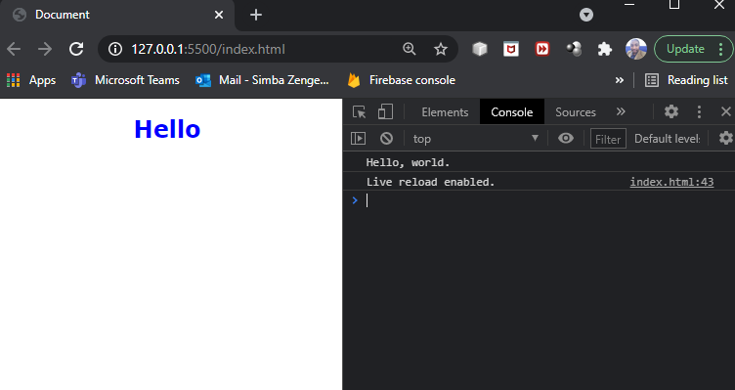
How JavaScript Gets Loaded on Browser
Click on Console:
This shows we are able to load our JavaScript code, in this index.html file, on the browser
Notes:
Under console, we now are able to see the result of our JavaScript: Hello, World

Slide 10
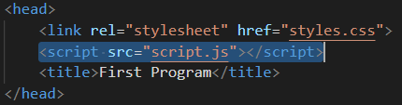
Running External JavaScript File
An external JavaScript resource is a text file with a .js extension, just like an external CSS resource with a .css extension.
To add a JavaScript file to your page, you just need to use a script tag with a src attribute pointing to the file.
So, if your file was called script.js and sat in the same directory as your HTML file, your script element would look like this:

Slide 11
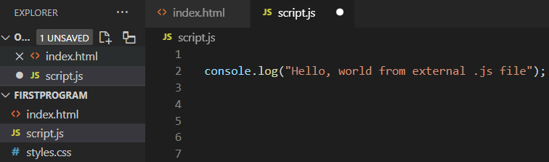
Running External JavaScript File
Lets create a JavaScript file in VS Code, named: script.js:
Load your index.html file again with Live Server, and check on browser.

Slide 12
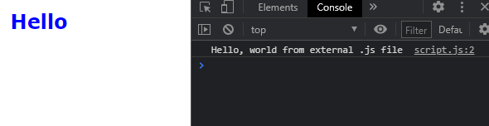
Running External JavaScript File
Output in browser console:
This is just one way of running JavaScript code (using browser console).
However, it may not be the best way available. VS Code comes with its own command prompt to show how JavaScript can be run in console.
To understand how that occurs, we need to first look at the next section.

Slide 13
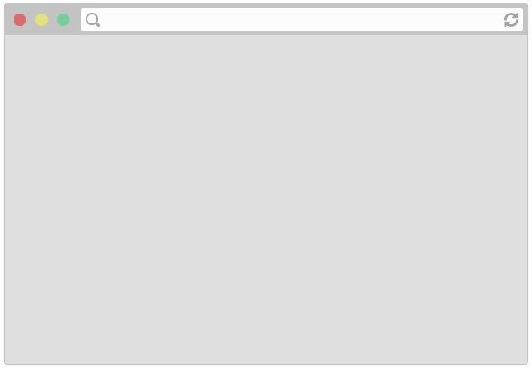

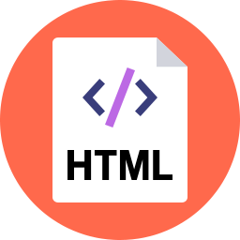
Running External JavaScript File
<head>
<title>CS 193X</title>
<link rel="stylesheet" href="style.css" />
<script src="script.js"></script>
</head>
The browser is parsing the HTML file, and gets to a script tag, so it knows it needs to get the script file as well.

Slide 14

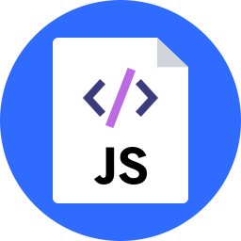
Running External JavaScript File
<head>
<title>CS 193X</title>
<link rel="stylesheet" href="style.css" />
<script src="script.js"></script>
</head>
And the server responds with the JavaScript file, just like it would with a CSS file or an image...

Slide 15
Running External JavaScript File
<head>
<title>CS 193X</title>
<link rel="stylesheet" href="style.css" />
<script src="script.js"></script>
</head>
console.log('Hello, world!');
Now at this point, the JavaScript file will execute "client-side", or in the browser on the user's computer.

Slide 16

JavaScript V8 Engine
https://v8.dev/
https://www.youtube.com/watch?v=86tgU7UaJmU

Slide 17

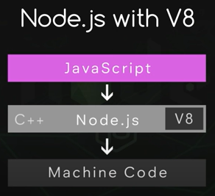
Node.js, JavaScript & V8 Engine
Node.JS is a C++ application that works with V8 engine to run JavaScript.
V8 Engine is embedded into Node.js.
We can now write JavaScript on VS Code, then run it through Node.js, which passes it to its V8 engine, and his engine can then convert our JavaScript code into machine code with the computer can understand.
Lets install Node on our PCs
https://nodejs.org/en/download/

Slide 18
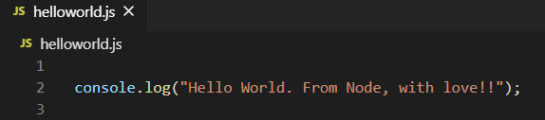
Running JavaScript code on Node.js
DEMO
Create a new folder on desktop, call it HelloWorld.
Open it in VS Code.
Create a JavaScript file. Call it helloworld.js, add the following:
To run/execute the JavaScript file in VS Code, first press Ctrl + ~

Slide 19
Running JavaScript code on Node.js
DEMO
Ctrl + ~ opens the Terminal in VS Code.
Type the following:
Output:

Slide 20
JavaScript Basics
JavaScript borrows most of its syntax from Java, C, and C++, but it has also been influenced by Awk, Perl, and Python.
JavaScript is case-sensitive and uses the Unicode character set.
letFirstname = “Zane“ :The variable Firstname is not the same as firstname because JavaScript is case sensitive.
Instructions are called statements and are separated by semicolons (;).
A semicolon is not necessary after a statement if it is written on its own line.
It is considered best practice, however, to always write a semicolon after a statement, even when it is not strictly needed.

Slide 21
Comments
Comments behave like whitespace, and are discarded during script execution.
The syntax of comments is the same as in C++ and in many other languages:
// a one line comment
/* this is a longer,
…
multi-line comment */
/* You can't, however, /* nest comments */ SyntaxError*/

Slide 22

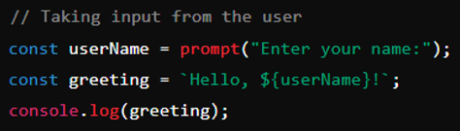
Hard-Coding
Hard coding involves embedding fixed values directly in the source code. These values do not change unless the code itself is modified:
Input and Output
Taking input from the user involves designing the program to accept values provided by the user at runtime. This makes the application dynamic and interactive:

Slide 23
Output in JavaScript
console.log() - prints on the console and also allows you to debug as it notifies you the errors encountered running the code.
document.write() – prints on the html webpage.
alert() – pop up printing on the screen.

Slide 24
Exercise:
Use the addendum provided, demonstrate the usage of:
prompt()
console.log()
document.write()
alert()
Notes:
Students can download Addendum provided and attempt the exercise. Memo provided too

Slide 25
Thank You!
The End
/belgiumcampusSA
#Belgium Campus
info@belgiumcampus.ac.za
+27 10 593 53 68
/belgiumcampus

